Slide 1
A fair comparison technique for fluid-structure interaction coupling algorithms
Jason P. Sheldon
Scott T. Miller
Jonathan S. Pitt
Distribution Statement A
Approved for public release
Distribution unlimited
deal.II workshop: August 20th, 2013

Slide 2
Presentation outline
Background
Motivation
General FSI concepts
Governing theory
FSI Testing
Turek and Hron FSI benchmark
deal.II implementation
Overview
Challenge areas
Future work

Slide 3
Motivation
Fluid-Structure Interaction (FSI)
The interaction of a deformable or elastic structure with the surrounding fluid
Motivating Goal
Analyze the effects of transient wake-induced loads on structures and the resultant flow

Slide 4
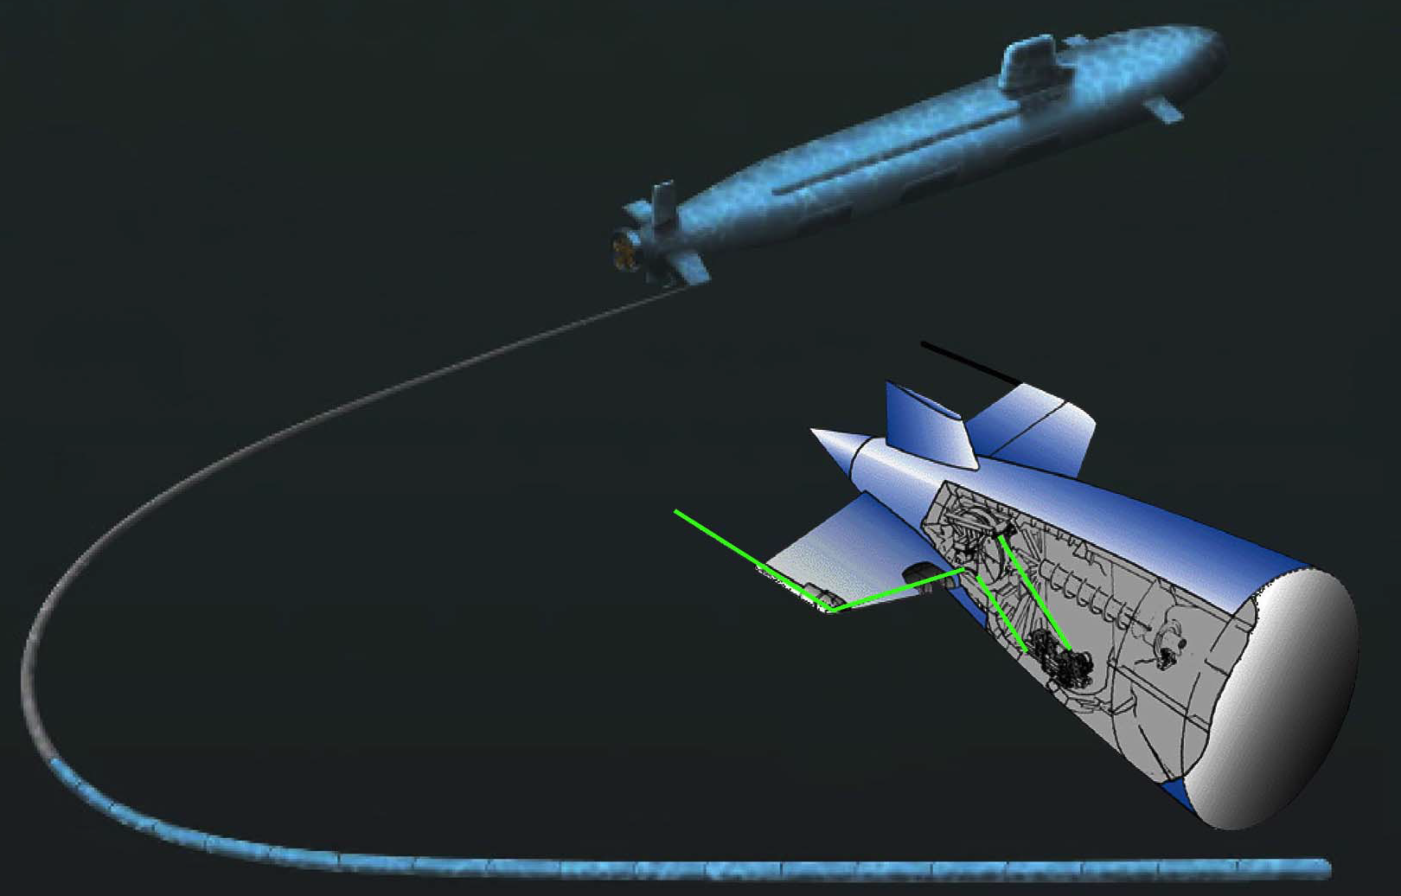
Motivation
Application areas of practical importance
Wake-structure interaction

Slide 5
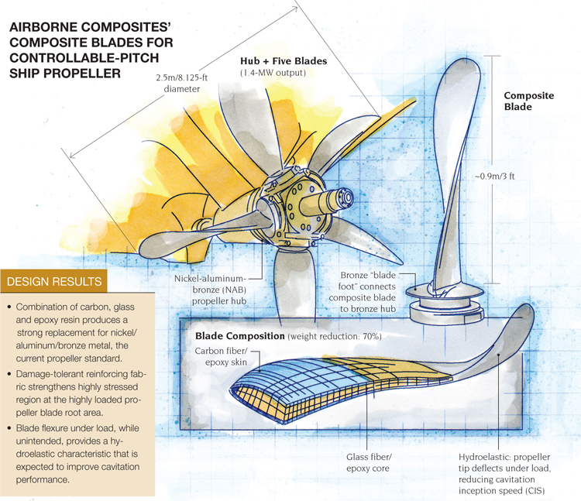
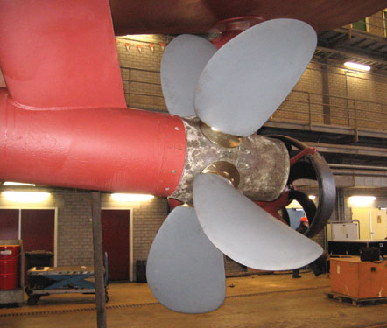
Motivation
Application areas of practical importance
Wake-structure interaction
Flexible composite propulsion systems
Notes:
Airborne International Composites’

Slide 6
Motivation
Application areas of practical importance
Wake-structure interaction
Flexible composite propulsion systems
Biomedical applications
etc.
Notes:
Airborne International Composites’

Slide 7
Motivation
Discovery
Multiple coupling types, some easier than others
Question
Which is best?
Literature review
Michler says that partitioned is better
Heil says that monolithic is better
Degroote says that it depends
Common point
Lack of strict convergence tolerances

Slide 8
Goal: Impartial comparison
Same governing equations
Same discretization strategies
Same coupling strength
Same convergence criterion
Same finite element implementation
deal.II
Same test case
Turek and Hron FSI Benchmark
Same mesh
Different coupling algorithms

Slide 9
Solid/Mesh governing equations
Elasticity
Lagrangian frame
St. Venant Kirchhoff model (solid)
Hookean model (mesh)

Slide 10
Fluid governing equations
Incompressible Navier-Stokes
Arbitrary Lagrangian-Eulerian (ALE) frame

Slide 11
Discretization
Standard numerical discretizations
Spatial
Bubnov-Galerkin finite element method
Taylor Hood elements for fluid
Temporal
Crank-Nicolson method

Slide 12
General FSI problem
Fluid Domain
Solid Domain
Fluid Boundary
Γ_{FS}
Solid Boundary
Fluid-Solid Interface

Slide 13
Partitioned FSI coupling
(Dirichlet-Neumann)
Segregated solves
Iterative interface conditions
Traction continuity
Velocity continuity
Admissible mesh displacements
t_{n}
Solve
fluid system
of equations
Solve
mesh system
of equations
Solve
solid system
of equations
Convergence check
No
Solid relaxation
Yes
t_{n+1}

Slide 14
Quasi-Direct FSI coupling
Combination of simultaneous and segregated solves
Solid and fluid
Single algebraic system
Iterative mesh displacement
Same as partitioned
One conforming velocity field
Implicit traction continuity
t_{n}
Solve coupled
fluid and solid system
of equations
Solve
mesh system
of equations
Convergence check
No
Yes
t_{n+1}

Slide 15
Monolithic FSI coupling
Simultaneous solves
Single algebraic system for everything
One conforming velocity field
Implicit traction continuity
One-way strong mesh displacement
Care must be taken to avoid having the mesh affect the solid displacement
t_{n}
Solve coupled
fluid, solid, and mesh system
of equations
t_{n+1}

Slide 16
Convergence Criterion
We use the same criterion for the partitioned and quasi-direct fixed-point iterations as for the monolithic Newton-Raphson iterations
This is satisfied when the fluid-solid interface does NOT move between iterations

Slide 17
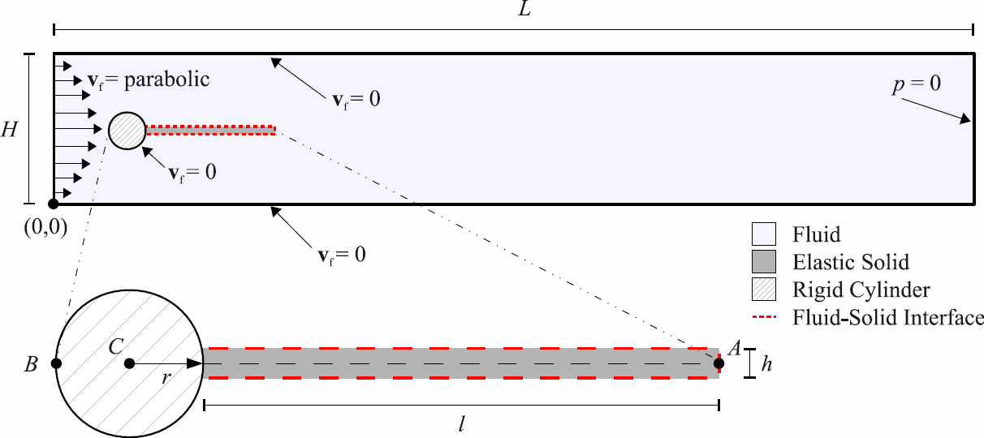
The Turek-Hron FSI benchmark

Slide 18
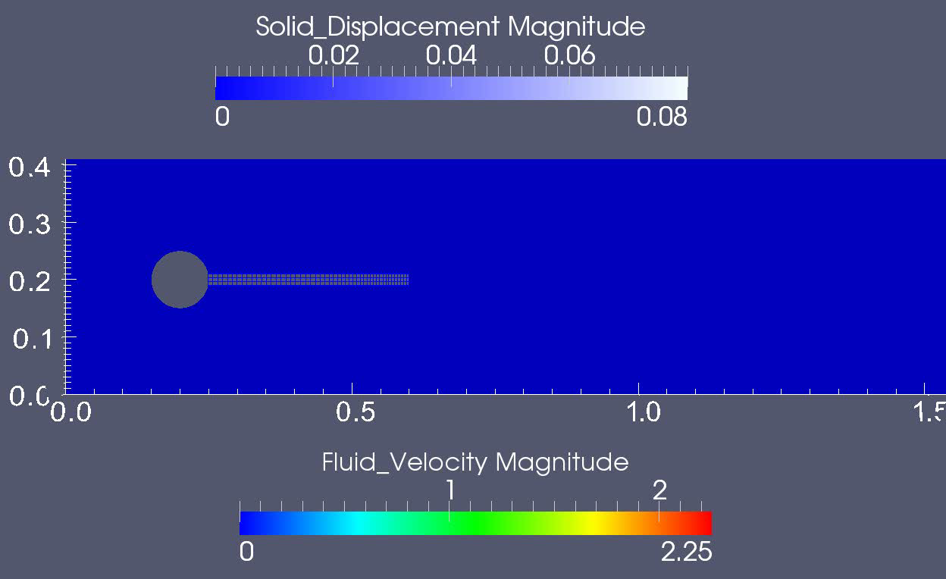
Benchmark visualization

Slide 19
Benchmark results
Displacement
Drag and Lift
FSI2 flag tip y-displacement vs. time:
excellent agreement for all coupling methods
FSI2 fluid-structure interface lift vs. time:
monolithic and quasi-direct closer match than partitioned
FSI2 fluid-structure interface drag vs. time:
monolithic and quasi-direct closer match than partitioned
FSI2 flag tip x-displacement vs. time:
monolithic and quasi-direct closer match than partitioned

Slide 20
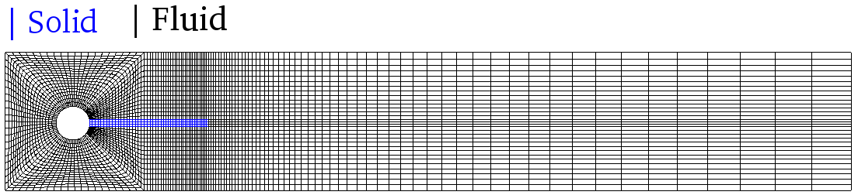
Benchmark results: Extrema
Quasi-Direct

Slide 21
Monolithic wins… this time
Quasi-Direct
Caveat: 2D, Laminar, Low Re, Serial

Slide 22
Research summary
Developed a computational FSI model
Three coupling types
Identical framework and convergence criteria
Turek-Hron benchmark case
All coupling types equally tightly coupled
Good agreement for all data
Monolithic coupling (Also quasi-direct)
Slightly more accurate than partitioned
Significantly faster than partitioned

Slide 23
deal.II implementation: Overview
Parameters
Triangulation
FE spaces
Etc.
fsi_handler
Partitioned
3 x 3 BlockSparseMatrix
3 x 1 BlockVector (s)
Quasi-Direct
Monolithic

Slide 24
deal.II implementation: Overview
Parameters
Triangulation
FE spaces
Etc.
fsi_handler
Partitioned
3 x 3 BlockSparseMatrix
3 x 1 BlockVector (s)
Fluid system assembly
Solid system assembly
Mesh system assembly
Quasi-Direct
“Couple”
Monolithic
Solve and post process

Slide 25
FEsystem
Input
Solid FE space = FESystem[FE_Q(p)^d-FE_Q(p)^d]
Fluid FE space = FESystem[FE_Q(p)^d-FE_Q(p-1)]
Mesh FE space = FESystem[FE_Q(p)^d]
FETools::get_fe_from_name
hp::FECollection
Output
Solid FE Space: FESystem<d>[FE_Q<d>(p)^d-FE_Q<d>(p)^d
-FE_Nothing<d>()^d-FE_Nothing<d>()-FE_Nothing<d>()^d]
Fluid FE Space: FESystem<d>[FE_Nothing<d>()^d-FE_Nothing<d>()^d
-FE_Q<d>(p)^d-FE_Q<d>(p-1)-FE_Q<d>(p)^d]
Notes:
Problem: 3 Finite element spaces of different sizes and potentially different orders, want to parameterize, current FESystems not implemented for larger than 5 objects
Step 46
Solution: Wrote an algorithm to combine FESystems, padding them with FE_Nothings of appropriate size into hp:Fecollections using the FETools::get_fe_from_name, which I had to modify to allow FESystems of arbitrary size (Note: Fluid and mesh are in the same System because they are on the same domain

Slide 26
Partitioned coupling
Implementation
Fluid: velocity continuity: constraints.set_inhomogeneity( … )
Solid: traction continuity:
Mesh: admissible displacements: constraints.set_inhomogeneity( … )
Convergence
Aitken’s relaxation
Notes:
Partitioned Implementation: treat as separate problems and solve normally with appropriate interface conditions Velocity continuity: add a constraint for each DOF on the interface of the fluid Traction continuity: add a term to the RHS of each DOF on the interface of the solid Mesh Displacements: add a constraint for each DOF on the interface of the fluid iterate to convergence Convergence: Aitkens relaxation of the solid promotes stability and convergence speed

Slide 27
Monolithic coupling
Implementation:
Fluid-Solid velocity continuity: constraints.add_line ( … ) constraints.add_entry ( … )
Fluid-Solid: traction continuity: satisfied implicitly
Mesh: admissible displacements
Tried: same as velocity continuity (does not work)
Tried: lagged displacement (works poorly)
Tried: quasi-direct (works)
Tried: Psuedo-strong coupling (works well!)
weak coupling + constraints.set_inhomogeneity( … ) again
Ideal: One-way constraint entry addition to the library
Convergence: Not Needed
Notes:
For the Fluid-Solid velocity continuity in the monolithic case, we need to add lines to the constraint matrix and entries that tie the velocity dofs on the interface for the fluid and solid and set them equal We need to do this both when we build the original sparsity pattern and when actually performing the coupling
Problem with this: Requires 1 to 1 velocity dofs on the interface for the solid and fluid (same number, same order) constraints.add_line (solid_face_dof_indices[solid_vel_dof[i]]);
constraints.add_entry (solid_face_dof_indices[solid_vel_dof[i]], fl_msh_face_dof_indices[fluid_vel_dof[i]], 1.0);
Benefit of conforming velocity field. Automatically satisfies traction continuity
Second Issue: Mesh displacements We tried to do this the same way, only to realize that we did not in fact want two way coupling between the solid and mesh displacement Artificial stiffness
Weakly enforce one-way coupling and then fix interface

Slide 28
Future work
Parallelization!
Equal order elements for fluid
Adaptive meshes
Iterative algebraic solver
Various temporal discretizations
Different/Modern finite element techniques
Overset?

Slide 29
Acknowledgements
deal.II workshop organizers
Naval Sea Systems Command, Advanced Submarine Systems Development Office (SEA 073R)
The Applied Research Laboratory at Pennsylvania State University

Slide 30
Thank you
Questions?

Slide 31
References
C. Michler, Computers & Fluids 33 , 839 (2004)
J. Degroote, K. Bathe, J. Vierendeels, Computers & Structures 87(11), 793 (2009)
M. Heil, Comput. Methods Appl. Mech. Engrg 193, 1 (2004)
S. Turek, J. Hron, Fluid-Structure Interaction pp. 371–385 (2006)

Slide 32
Motivation Image Sources
Minehunter with composite prop image
http://www.compositesworld.com/articles/composite-propeller-for-royal-navy-minehunter(2)
Lockheed Martin towed-array image
http://www.lockheedmartin.com/data/assets/Towed_Array.pdf
Aortic valve model image
Arterial blood flow model image

Slide 33
Bonus slides follow

Slide 34
Spatial discretization

Slide 35
Spatial discretization
Trial solution spaces
Weighting function spaces

Slide 36
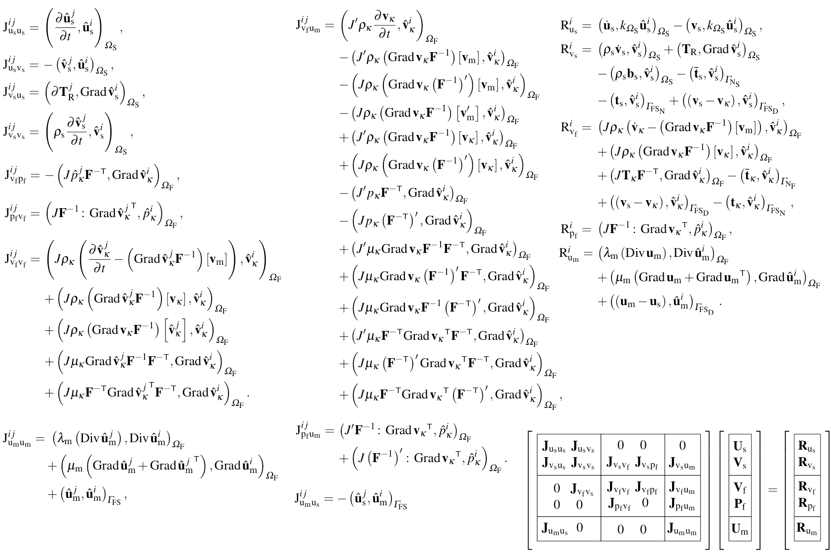
Residuals and Jacobians

Slide 37
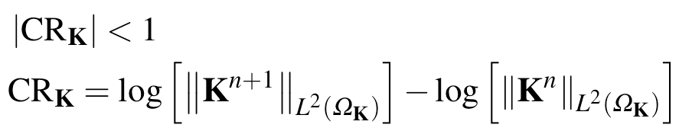
Convergence and relaxation
FSI iteration convergence
Solid relaxation
Newton-Raphson iteration convergence

